Slide 1

EMERGENCY SOS APP (SOS = SAVE OUR SOULS)

Slide 2
CONTENTS OF APP
First of all this app has a login page which includes User’s name, date of birth, gender, address, mobile number, email id & there should be 3 family or friends mobile number included for emergency contact .
App will trace current location /geo location via GPRS of users mobile once logged in.
After clicking the button it will take you to another page.
The next page will have 5 buttons:-
1ST Button is of Ambulance provider helpline.
2. 2ND Button is of Police helpline.
3. 3RD Button is of Fire brigade helpline.
4TH Button is of Child helpline number.
5TH Button is of Women helpline number.
NOTE : Further to add that this App will send pictures Automatically from rear & front camera of users mobile (who is in need of SOS help) to 3 mobile numbers of persons saved in emergency contact on pressing any of the above button, via what’s app .

Slide 3
USE OF APP
It will help the people to deal with emergency situations that are faced in their routine life ; such as health emergency , women harassment , child harassment , eve teasing ,fire, burglary, racism, and or to deal with any emergency situation.

Slide 4
SOFTWARE IN WHICH APP WILL BE CREATED
I am going to use snack expo.io to create the app and I am going to link it with firebase.database

Slide 5
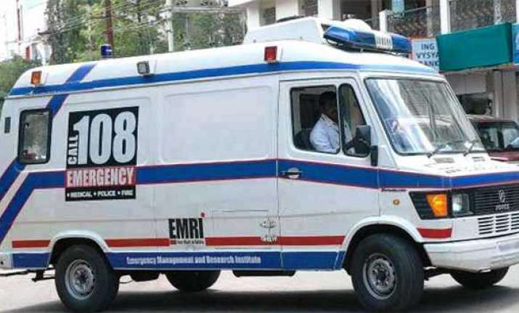
AMBULANCE HELPLINE BUTTON
If someone who is in need of help will press this button , then it will directly send information that in which location they are and in case if ambulance what’s app number is in data base it will also send their images to the nearest ambulance provider. Thus, enabling people to contact ambulance in a faster manner during an emergency situation.

Slide 6
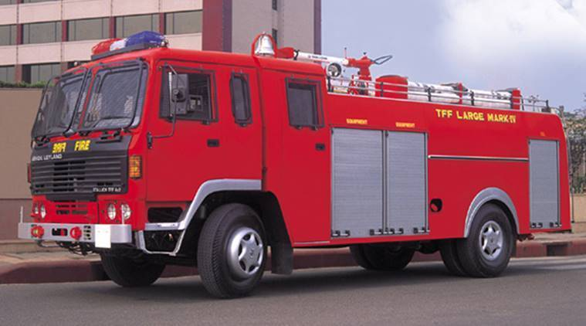
FIREBRIGADE HELPLINE BUTTON
If someone who is in need of help will press this button , then it will directly send information about their current location of the person who has pressed the fire brigade button and in case if fire brigade what’s app number is in data base it will also send their front and back images . thus, contacting to fire brigade station will become more easy and fast.

Slide 7

POLICE HELPLINE BUTTON
If someone who is in need of help will press this button , then it will directly send information about their current location and in case if police what’s app number is in data base it will also send their front and back images . thus , enabling the police to reach to the place where the crime has been committed much faster .

Slide 8

CHILD HELPLINE button
If a teenager/child who is in need of help will press this button , then it will directly send information about their current location and in case if, child help line what’s app number is in data base, app will also send their front and back images. Thus, helping the child will become more faster

Slide 9

WOMENS HELPLINE button
If a girl/lady who is in need of help will press this button, then it will directly send information about their current location and in case if women helpline what’s app number is in data base it will also send their front and back images. Thus, reaching them will become more faster & easier

Slide 10

THANK YOU FOR YOUR VALUABLE TIME project created by : SHUBHAM SHAH ahmedabad –gujarat – india mobile no. - +91-9331023880 email id –deva2504@gmail.com

